Slide 1

EventGuard
Event Insurance Management System
Capstone Project | Presented by Katta Sai Rutvik
A digital platform for intelligent event risk assessment, policy management, and automated insurance processing.
Notes:
1

Slide 2




Understanding Event Insurance
Event insurance is a specialized form of coverage designed to protect event organizers from financial losses caused by unexpected disruptions, accidents, or operational failures during events.
Financial Protection
Risk Mitigation
Safeguards investments related to venue booking, logistics, vendors, and event infrastructure
Covers fire damage, theft of equipment, severe weather conditions, and sudden event cancellations
Liability Coverage
Protects against crowd-related incidents, safety failures, and damage to third-party property
Different categories of events require insurance coverage, including concerts, corporate gatherings, conferences, weddings, exhibitions, and outdoor festivals. Managing insurance for such diverse events requires structured risk evaluation and policy selection based on event characteristics and potential hazards.
Notes:
2

Slide 3
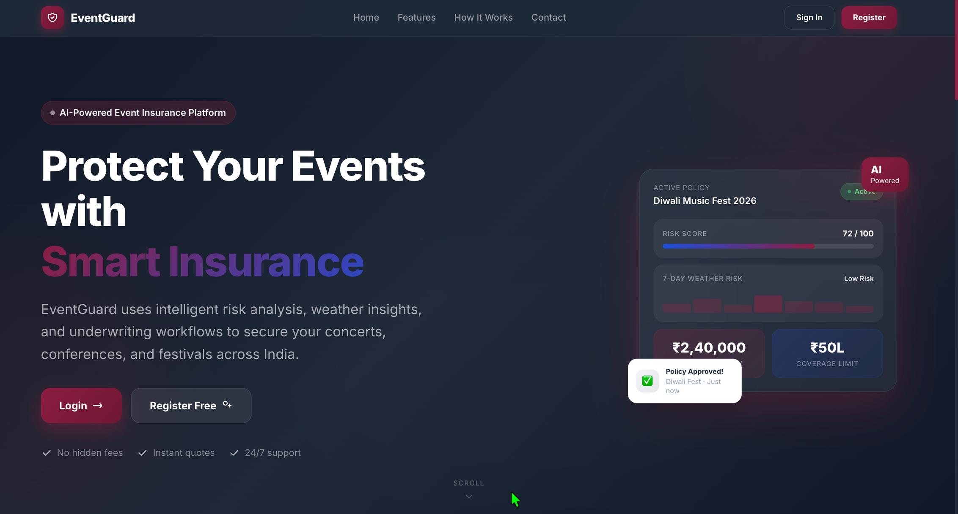
Why EventGuard?
The increasing scale and complexity of modern events demand a structured digital system to efficiently manage insurance policies and risk assessments. Traditional approaches fall short in delivering the transparency and efficiency required by today's event organizers.
Inconsistent Manual Evaluation
Limited Transparency
Manual risk assessment leads to inconsistent decision-making and inaccurate premium estimation
Customers experience limited visibility into how premiums are calculated and risks are evaluated
Slow Approval Processes
Coordination Challenges
Without automation, policy subscription and approval processes become slow and difficult to track
Operations require coordination between multiple stakeholders without clear workflow structure
Notes:
3

Slide 4
Problems with Traditional Systems
Manual Documentation
Data Entry Errors
Policy subscriptions and risk assessments handled through paperwork and physical documentation, increasing administrative burden
Heavy dependence on manual processes introduces data entry errors and inconsistent evaluations across different events
Delayed Approvals
Weak Risk Analysis
Policies pass through multiple departments without unified digital workflow, causing significant approval delays
Non-standardized risk analysis methods lead to inaccurate premium calculations and inconsistent policy pricing
Poor Communication
Slow Claim Processing
Gaps between administrators, underwriters, and claims officers result in confusion and inefficient coordination
Lack of centralized tracking and digital claim management systems makes processing complicated and time-consuming
Notes:
4

Slide 5
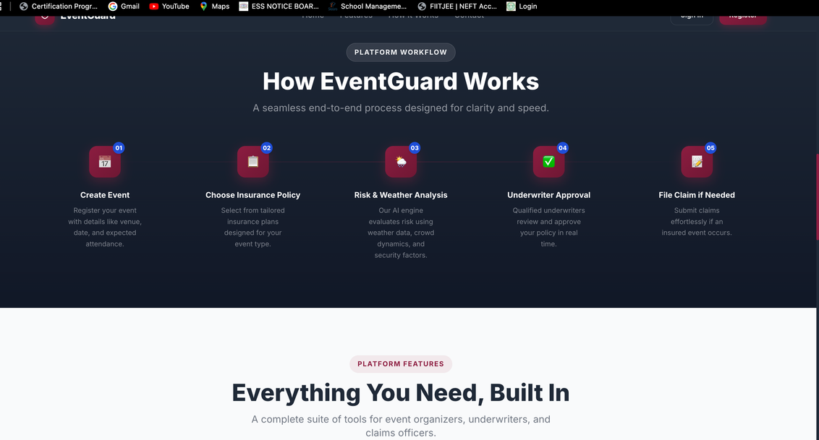
Introducing EventGuard
A Centralized Insurance Management Platform
EventGuard digitizes the entire lifecycle of event insurance operations, providing a comprehensive solution for modern event risk management.
01
02
Digital Event Records
Policy Selection
Customers create event records with event type, location, budget, and duration
Users select suitable insurance policies based on event category and coverage needs
03
04
Automated Risk Evaluation
Weather Risk Analysis
Rule-based logic analyzes event characteristics and operational parameters
Additional analysis for outdoor events using weather data integration
05
06
Premium Calculation
Workflow Management
Automated premium estimation using policy base rates and risk levels
Structured approval workflow with administrator assignment of underwriters
Notes:
5

Slide 6
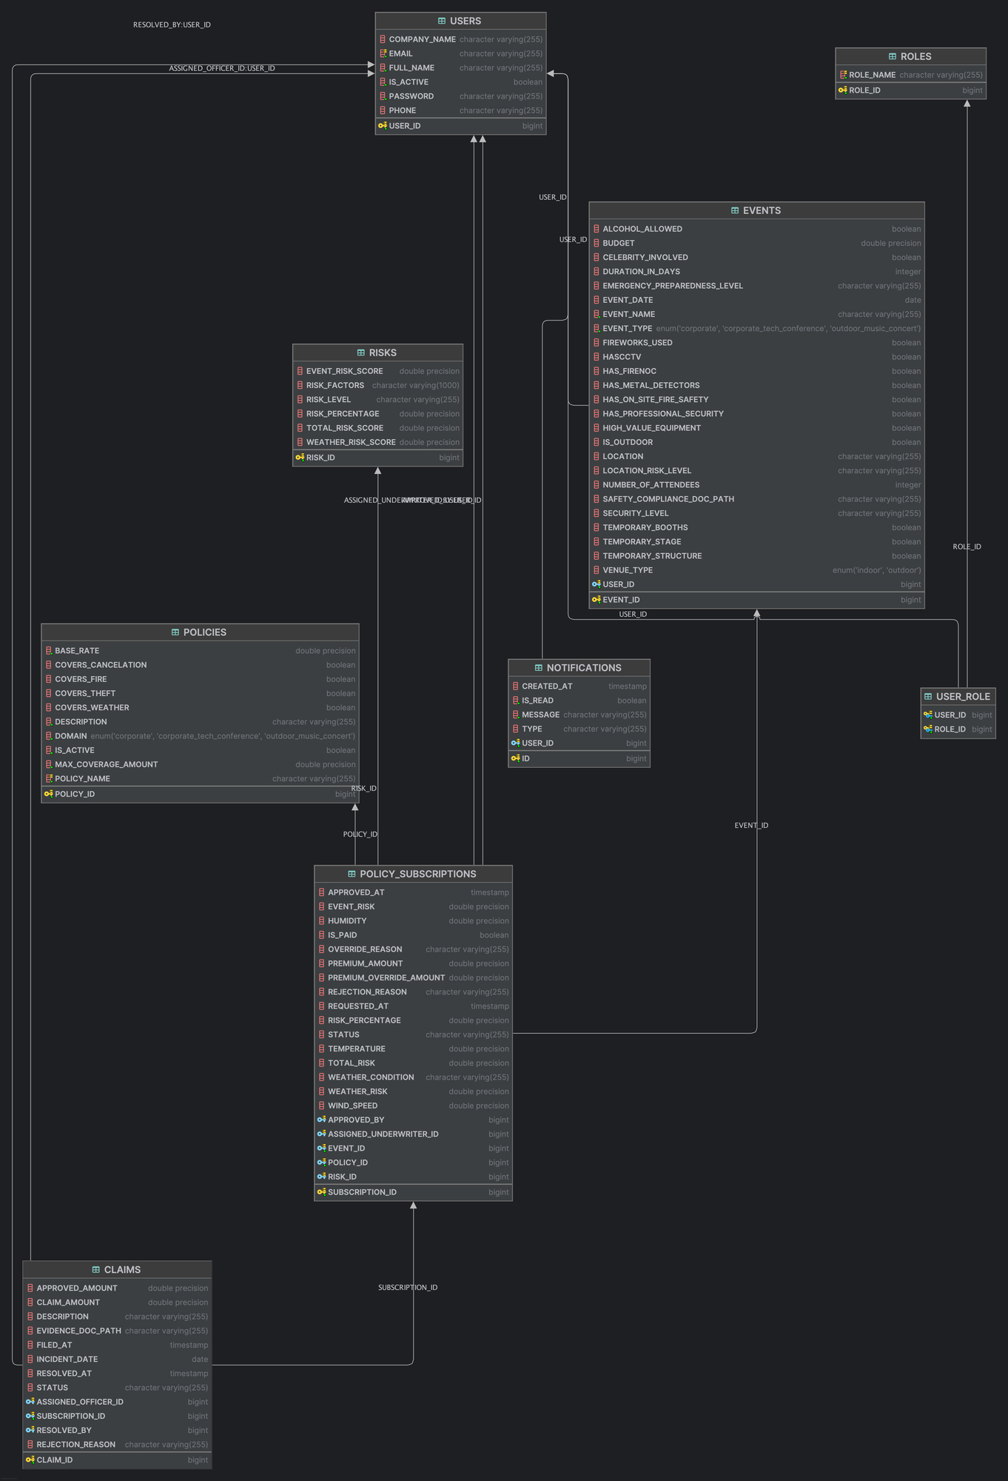
ER DIAGRAM
Notes:
5

Slide 7
Technology Stack
Angular
Spring Boot (Java)
Responsive and interactive user interface for managing events, policies, subscriptions, and claims efficiently
Core business logic for event data handling, risk calculations, premium generation, authentication, and workflow management
H2Console
JWT & Spring Security
Structured storage for user profiles, event details, policies, subscriptions, premium records, and claim data
Secure API access with role-based authorization restricting functionality according to user roles
REST APIs
Weather API Integration
Seamless communication between Angular frontend and Spring Boot backend for data exchange
External weather services for weather risk data on outdoor events, improving risk assessment accuracy
Testing Frameworks: Jasmine and Karma for frontend testing; Maven and JUnit for backend services and API testing
Notes:
6

Slide 8

System Roles and Access Control
Role-based access control ensures each user performs only actions relevant to their responsibilities, improving security and accountability.
1
Customer
Creates events, selects insurance policies, views premium estimates, subscribes to policies, makes payments, and submits claims when required
2
Administrator
Manages system operations including policy configurations, event oversight, and assignment of underwriters to evaluate policy subscriptions
3
Underwriter
Analyzes subscription requests, reviews calculated risks and event details, and makes approval or rejection decisions based on insurance guidelines
4
Claims Officer
Evaluates submitted claims, verifies supporting documentation, and determines claim approvals or settlements according to policy conditions
Notes:
7

Slide 9








System Workflow
From Event Creation to Policy Activation
Event Creation
Policy Selection
Customer creates event with type, budget, location, and schedule details
Customer selects appropriate insurance policy matching event coverage requirements
Risk Analysis
Weather Integration
System evaluates event size, venue type, duration, and complexity for risk assessment
Additional weather risk analysis for outdoor events using weather data
Premium Calculation
Underwriter Review
System combines risks to generate total risk score and estimates premium with pending subscription
Administrator assigns subscription to underwriter for professional evaluation
Payment & Activation
Claims Processing
Underwriter approves or rejects; customer completes payment to activate policy
Active policy allows customers to submit claims for incidents; claims officers review and process
Notes:
8

Slide 10
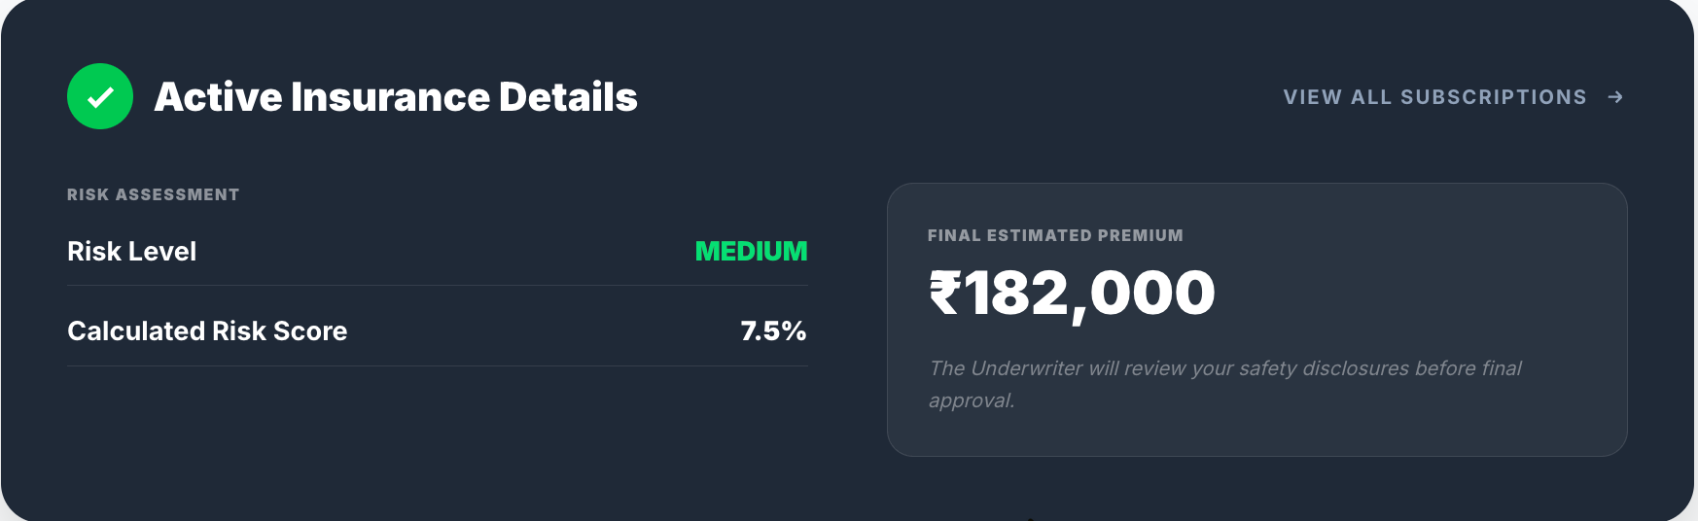
Automated Risk-Based Premium Calculation
Core Functionality in Detail
EventGuard's automated premium calculation ensures consistent pricing, transparent calculations, and improved decision-making through systematic risk evaluation.
Formulas Used
Base Premium Formula:
Base Premium = Event Budget × (Policy Base Rate / 100)
Final Premium Formula:
Calculation Process
Final Premium = Base Premium × Risk Multiplier
Risk Multiplier Logic
if (Total Risk > 15) multiplier = 2.0
else if (Total Risk > 10) multiplier = 1.6
else if (Total Risk > 5) multiplier = 1.3
else multiplier = 1.0
Risk Level Classification
Event Risk Evaluation
if (Total Risk > 10) Risk Level = HIGH
else if (Total Risk > 5) Risk Level = MEDIUM
else Risk Level = LOW
Weather Risk Analysis
For outdoor events, weather conditions contribute to risk assessment
Risk Classification
Total Risk Score
Event classified as low, medium, or high risk based on total risk value
System combines event and weather risks for overall exposure level
Notes:
9

Slide 11


Conclusion
Key Achievements
Future Enhancements
Centralized Platform
Machine Learning Integration
Digitized the entire event insurance lifecycle with structured workflows
Predictive analytics for more accurate risk assessment
Mobile Application
Automated Risk Analysis
On-the-go access for event organizers and claims officers
Rule-based logic ensures consistent premium calculations
Blockchain Integration
Improved Transparency
Secure, immutable record-keeping for all transactions
Clear visibility into policy status and approval progress
Expanded Coverage
Efficient Processing
Additional insurance products for specialized event types
Faster policy approvals and streamlined claim management
"EventGuard represents a significant step forward in event insurance management, combining automation, transparency, and efficiency to serve the evolving needs of modern event organizers."
Notes:
10

